Slide 1

Your past, your present and your future

Slide 2


Slide 3


Slide 4
Overview
Idea
Technologies
Competitors
Costs
Team
Planification
Demo
Piloting plan

Slide 5
IDEA
What is Capsulefy?

Slide 6





Time capsule

Slide 7


Deadman switch
ON

Slide 8


Payment plans
 | Free | Premium
Price | 0 € | 11.99 €
Storage | 20 MB/user | 500 MB/capsule
Social network and email integration
Capsule scheduling | 1 year | No limit
Capsule expiration | 6 months after release | No expiration
Modular and private capsules

Slide 9
Quality (p) | MB/minute
144 | 1.3
240 | 3.3
360 | 5
480 | 8.3
720 | 25
1080 | 50

Slide 10
TECHNOLOGIES
What stack do we use?

Slide 11





Web app
Users and capsules
Media storage
Social networks

Slide 12


Testing
Functional and integration
Performance
Coverage

Slide 13





Slide 14
COMPETITORS
What makes us different?

Slide 15
 | Viajeros en el tiempo | Mytimecapsule | Miigen | thetimecapsule | Capsulefy
Automatic content publication
Free plan
Premium plan
Images
Videos
Social network integration
Deadman switch

Slide 16
COSTS
How much does Capsulefy cost?

Slide 17


Realistic | 29968.20 – 31330.29 €
Optimistic | 28061.13 €
Pesimistic | 34054.77 €
Project duration: 4 months

Slide 18
Project duration | 4 months
Salaries | 20.80 €/hour
Hours per month | 40
Amortization | 60 months
Equipment | 306.67 €
Hosting (1 year) | 669.34 €
Advertising (6 months) | 3060 €
Risk prevention | 10% (2724.38 €)
Total | 29968.20 €

Slide 19

Monthly advertising costs
220 €
140 €
150 €

Slide 20
Year 1: 2000 sales
Balance: -10168 €
Year 2: 4000 sales
Balance: 16273 €
29968 €
39600 €
19800 €
13159 €
Costs
Earnings
Costs
Earnings

Slide 21
Year 3: 8000 sales
Balance: 81450 €
79200 €
14023 €
Costs
Earnings

Slide 22
TEAM
Who is behind?

Slide 23
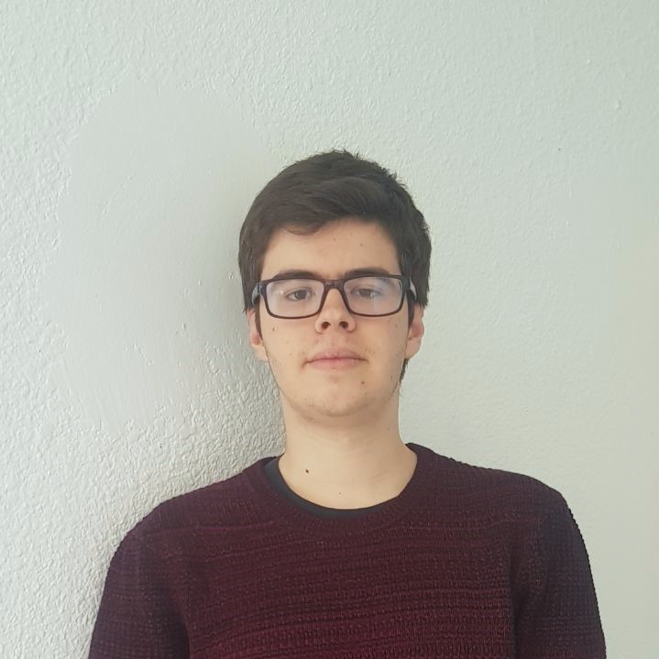
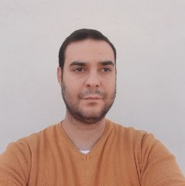




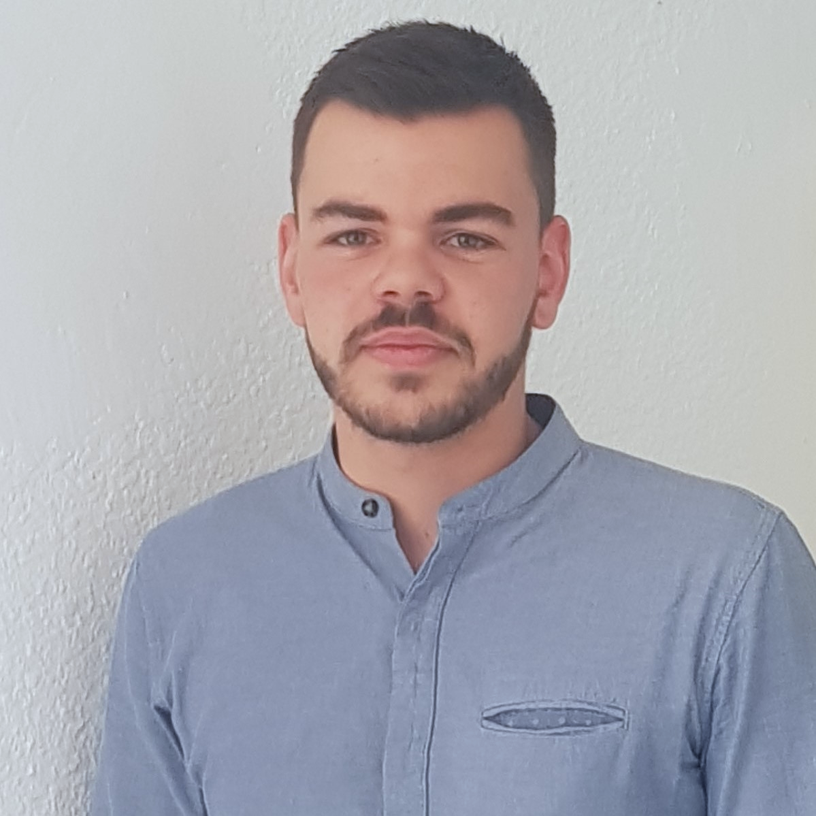
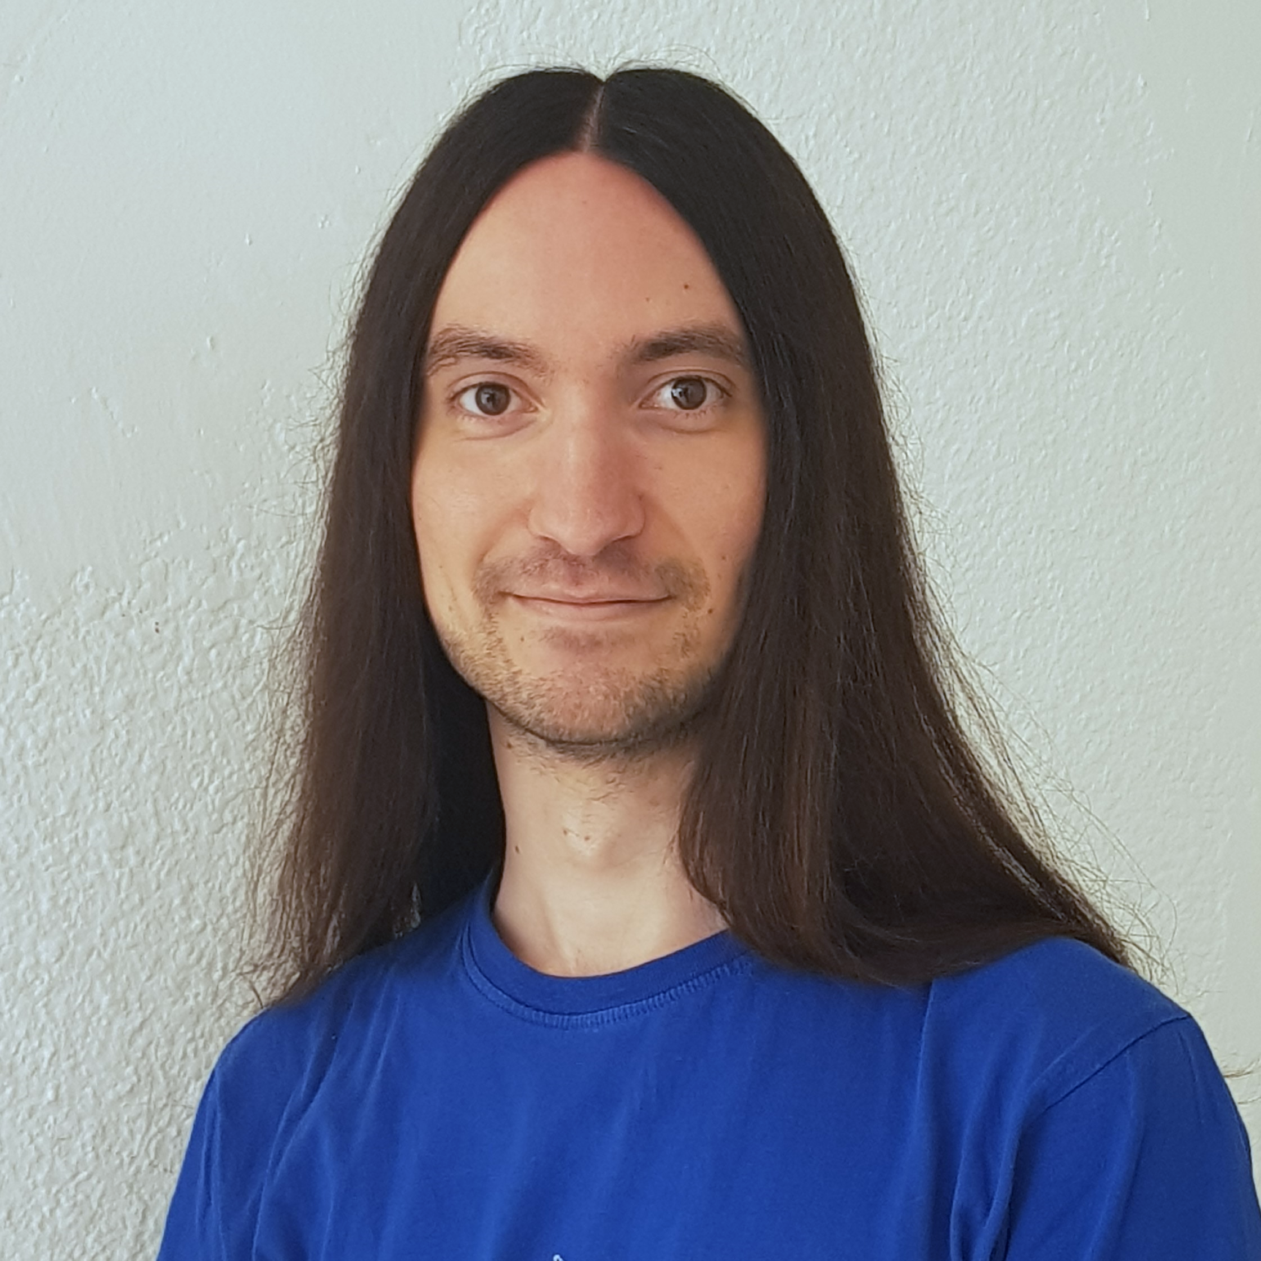


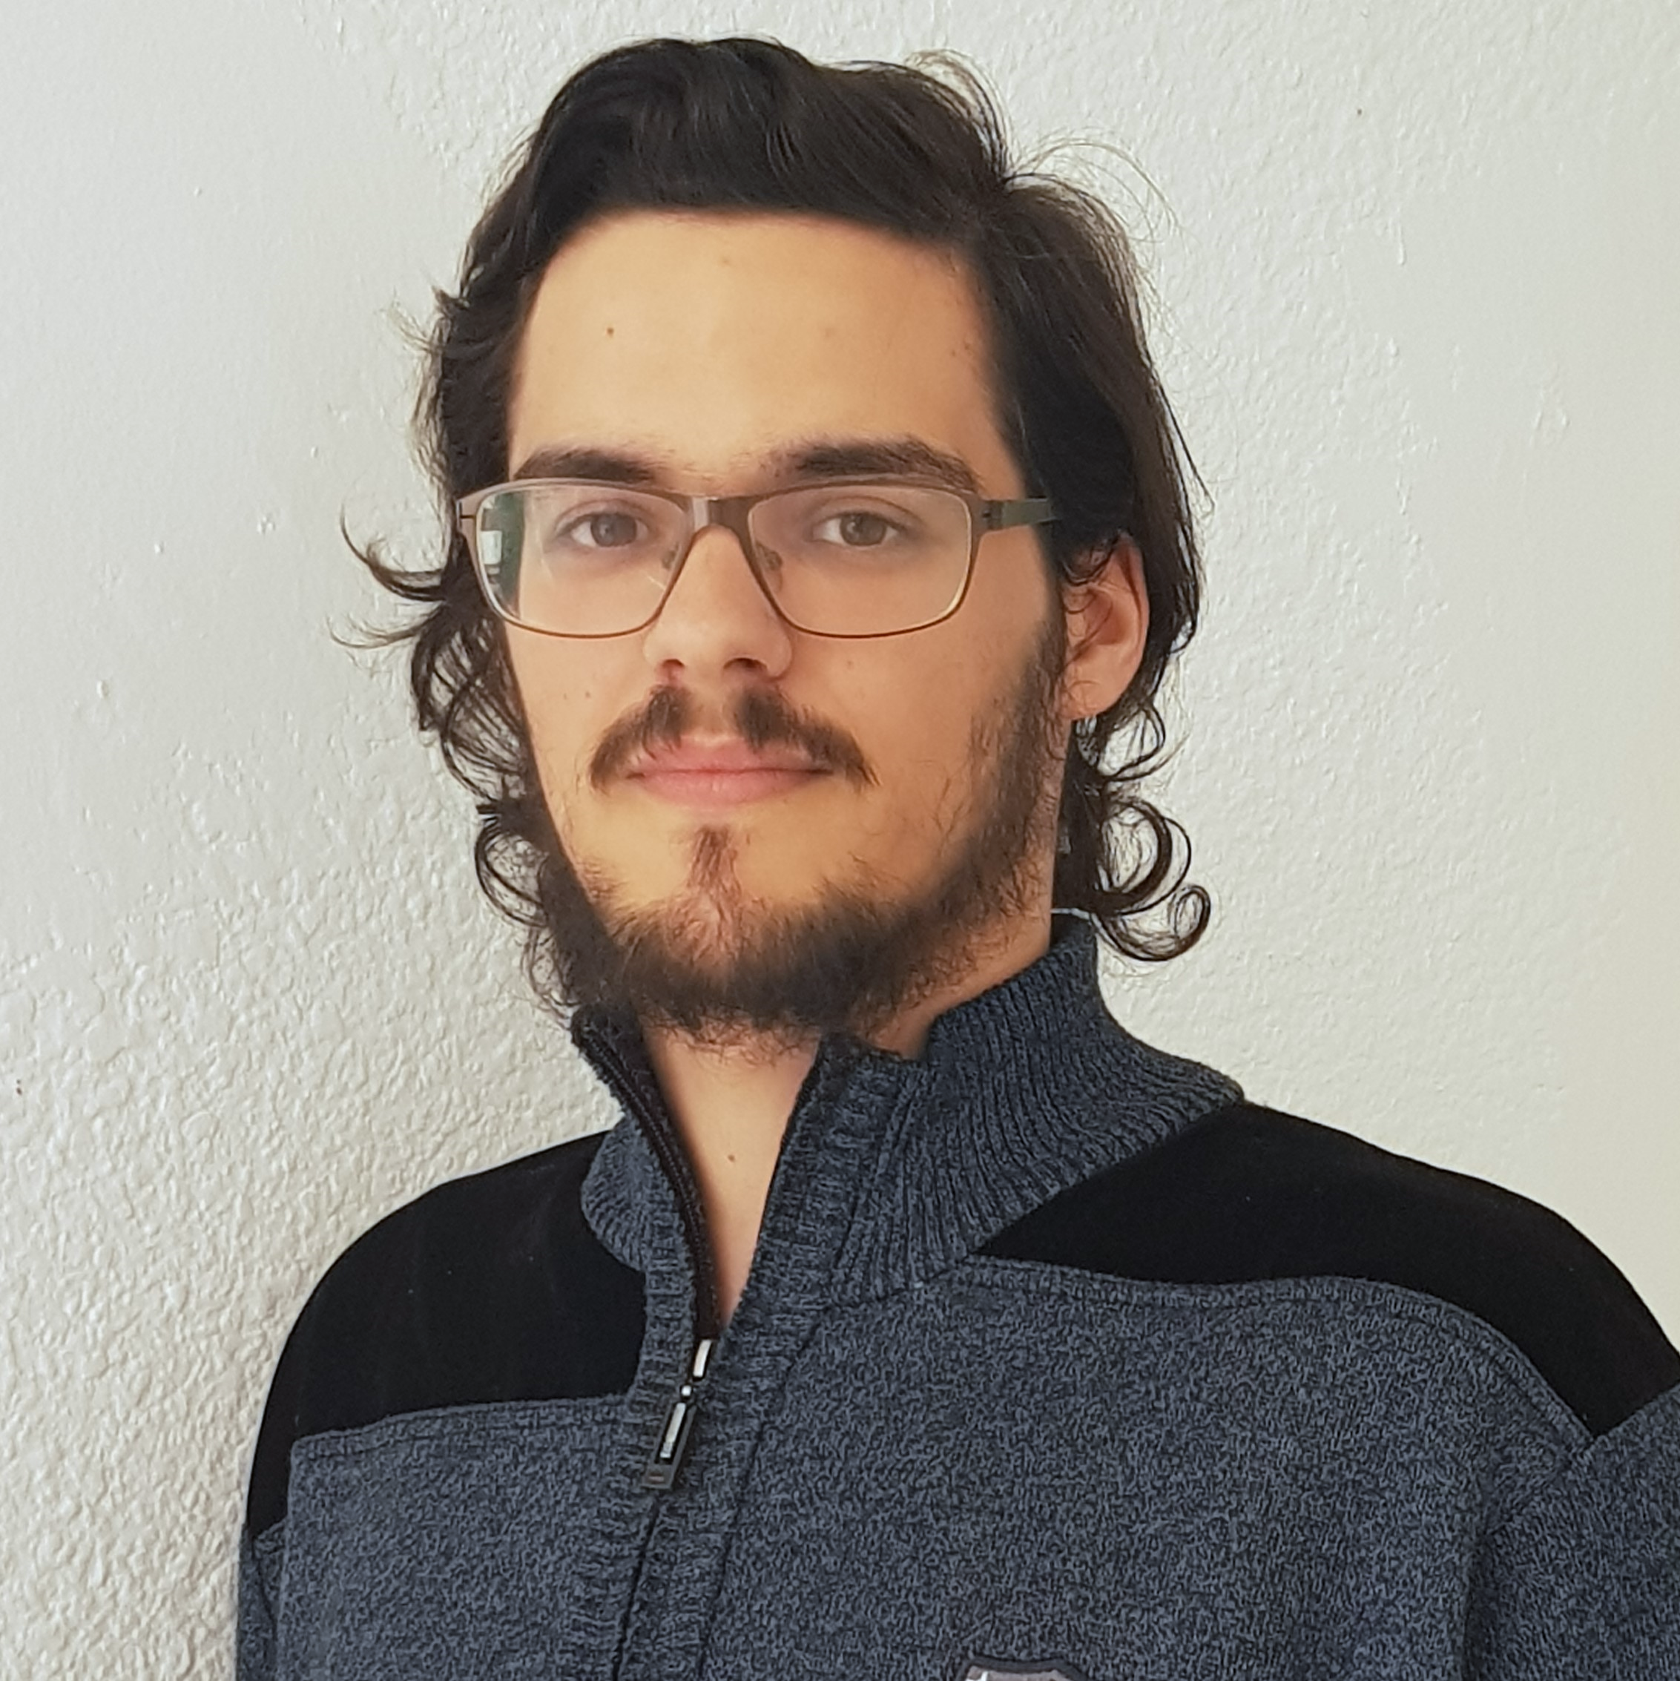



Pablo Rebollo
Project manager, backend developer
Juan Rodríguez
Requirements engineer, backend developer
Adrián Cantón
Business manager, full-stack developer
Rafael Fresno
Backend developer, API integration
Daniel Carpio
Analist,
frontend developer

Slide 24
PLANIFICATION
How do we organize development?

Slide 25
First sprint March 18th – March 29th | Core use cases Piloting plan
Second sprint April 1st – April 12th | Full MVP Feedback taken into account
Third sprint April 22nd – May 3rd | Polished MVP

Slide 26



Performance indicator
$$avg(\frac{Estimated time}{Invested time})$$
~
>= 0.5
< 0.8
>= 0.8
<= 1.2
> 1.2
<= 1.5
!
?
< 0.5
> 1.5

Slide 27



Factors affecting performance
Optimistic estimation
Wasted time
Difficulties
Pesimistic estimation
Easier tasks
Unknown technology

Slide 28



General solutions
Talk
Reschedule
Balance
Monitor

Slide 29
SPRINT 1 WEEK 1
March 18th – March 22nd

Slide 30
Task | Assignees | Est. (h) | Inv. (h) | Status
Data model | Adrián, Daniel | 4 | 1.5 | Finished
Set up environment | All | 2.5 | 2.5 | Finished
Angular research | Daniel | 1 | 2 | Aborted
Data model implementation | Juan | 2.5 | 2 | Finished
Populate database | Pablo | 2 | 3.2 | Finished
Basic capsule CRUD | Rafael | 2.5 | 9 | To be tested
Display capsules | Adrián | 2 | 5 | To be tested
TIME

Slide 31
Task | Assignees | Est. (h) | Inv. (h) | Status
Listing capsules | Juan | 1.5 | 1 | To be tested
User login | Juan | 1 | 1 | To be tested
Advertisement budget | Pablo | 1.5 | 1.5 | Finished
User interface | Daniel | 1 | 10 | Finished
Documentation | Daniel, Adrián, Juan | 1.5 | 1.5 | Finished
Presentation | Pablo, Rafael | 3 | 4 | Finished
Review meeting | All | 2.5 | 2.5 | Finished
TIME

Slide 32
Performance
Adrián | 1.34
Daniel | 1.05
Rafael | 0.67
Pablo | 0.84
Juan | 1.06

Slide 33



What went wrong?
No Angular knowledge
Bad estimations
Lack of time

Slide 34
SPRINT 1 WEEK 2
March 25th – March 29th

Slide 35
Task | Assignees | Est. (h) | Inv. (h) | Status
Feedback meeting | All | 5 | 5 | Finished
Travis CI set up | Adrián, Rafael | 2 | 3 | Finished
Modular capsules | Adrián | 5 | 4.5 | Finished
Private capsules | Juan | 2 | 1.5 | Finished
Email automation | Juan | 2 | 1.5 | Finished
Search capsules | Daniel | 1.5 | 1 | Finished
List own capsules | Juan | 1 | 1 | Finished
Pagination | Juan | 1 | 3 | Finished
TIME

Slide 36
Task | Assignees | Est. (h) | Inv. (h) | Status
Deadman switch | Pablo | 4 | 5 | Finished
Social network integration | Rafael | 4 | 1 | Postponed
User interface | Daniel | 4 | 7 | Finished
Piloting plan | Adrián | 2.5 | 1 | Finished
Sprint meeting | All | 5 | 5 | Finished
Documentation | Adrián, Daniel, Juan | 1.5 | 1.5 | Finished
Presentation | Rafael | 3 | 5.5 | Finished
Deliverable | Pablo | 3 | 4 | Finished
TIME

Slide 37
Performance
Adrián | 1.32
Daniel | 1.03
Rafael | 0.60
Pablo | 0.77
Juan | 0.87

Slide 38


What went wrong?
Performance further reduced
Implementation differences
Lack of time

Slide 39
What actions were taken?
Meet
Reschedule
Reestimate

Slide 40
Total performance
Adrián | 1.31
Daniel | 1.02
Rafael | 0.63
Pablo | 0.80
Juan | 0.96

Slide 41


Lessons learnt: organization
Too many core use cases
Bad estimations
Lack of coordination
Dependencies

Slide 42


Lessons learnt: technologies
Unknown technlogies
Low code quality
Implementation differences
Deployment problems

Slide 43



Taken actions
Detailed planning
Time for documentation
Better tool usage
Divide tasks

Slide 44
SPRINT 1 RESULTS
What was produced?

Slide 45
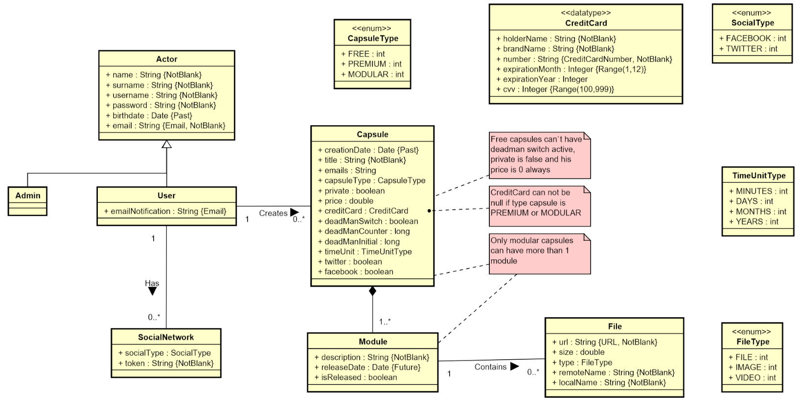

Slide 46
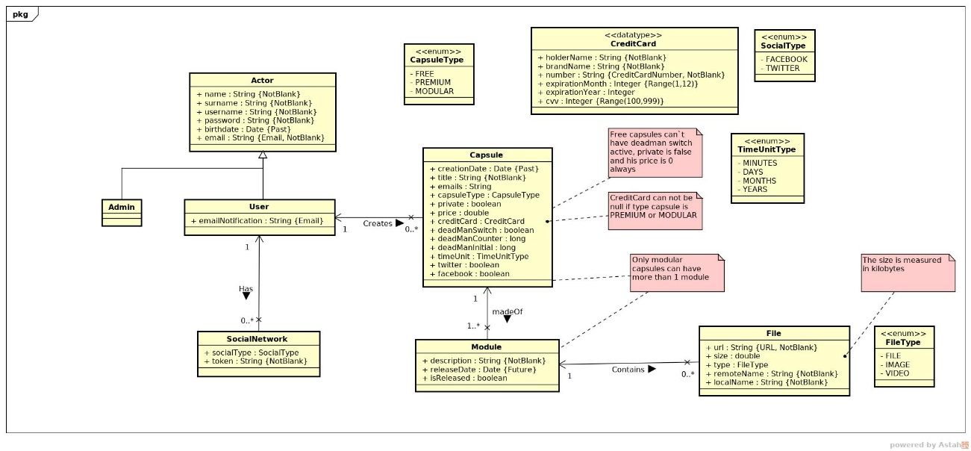

Slide 47
Documentation
Sprint 1 documentation
Piloting plan
Development
Frozen app: https://capsulefy02.herokuapp.com
GitHub release: https://github.com/pabreblob/capsulefy/releases

Slide 48
Project duration | 7 weeks (2 development)
Salaries | 20.80 €/hour
Hours per month | 40
Total salaries | 6989 €
Amortization | 60 months
Equipment | 134.16 €
Hosting | 0 €
Advertising | 0 €
Total | 7123.16 €

Slide 49
DEMO
How does the system look like?

Slide 50
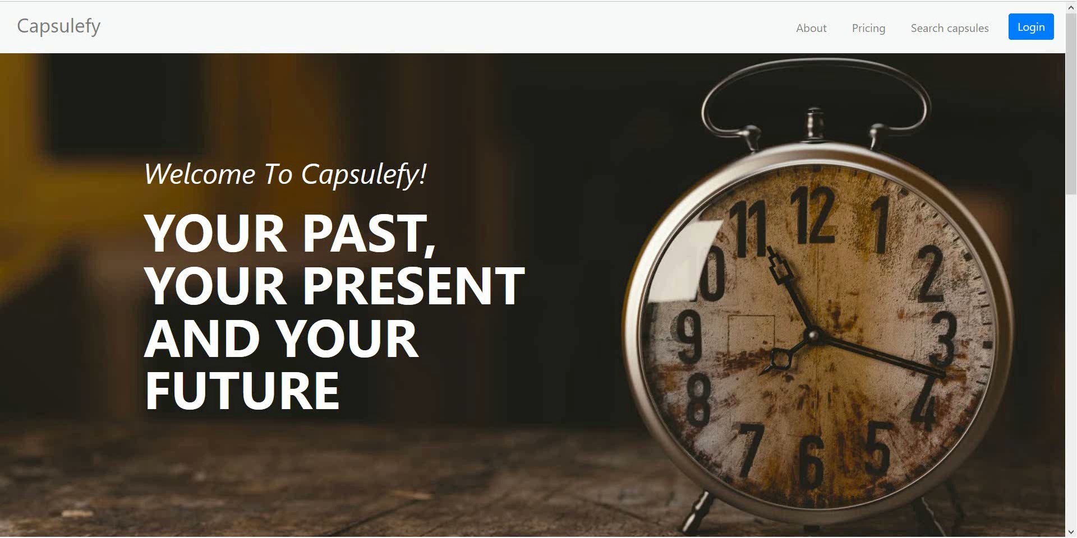
No logged user – List, search and display capsules

Slide 51
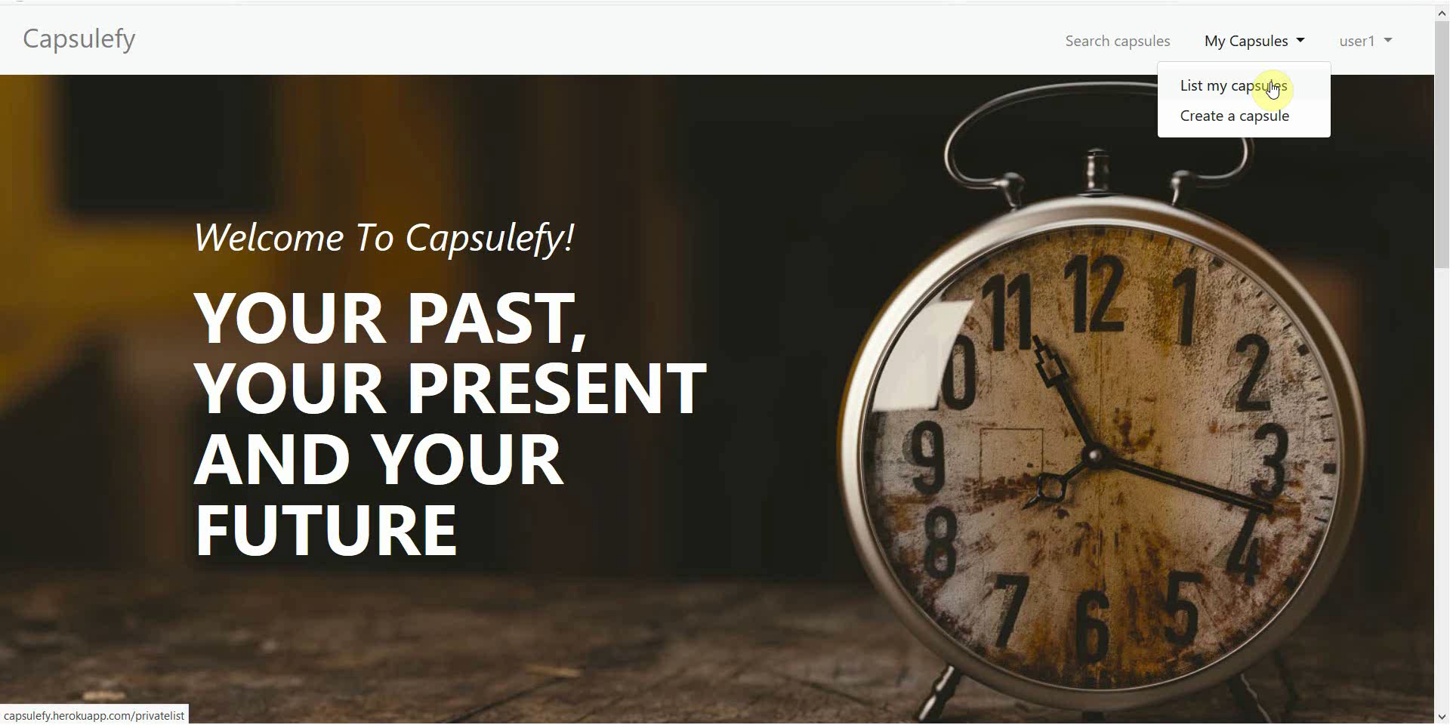
Logged-in user – Create premium capsule

Slide 52
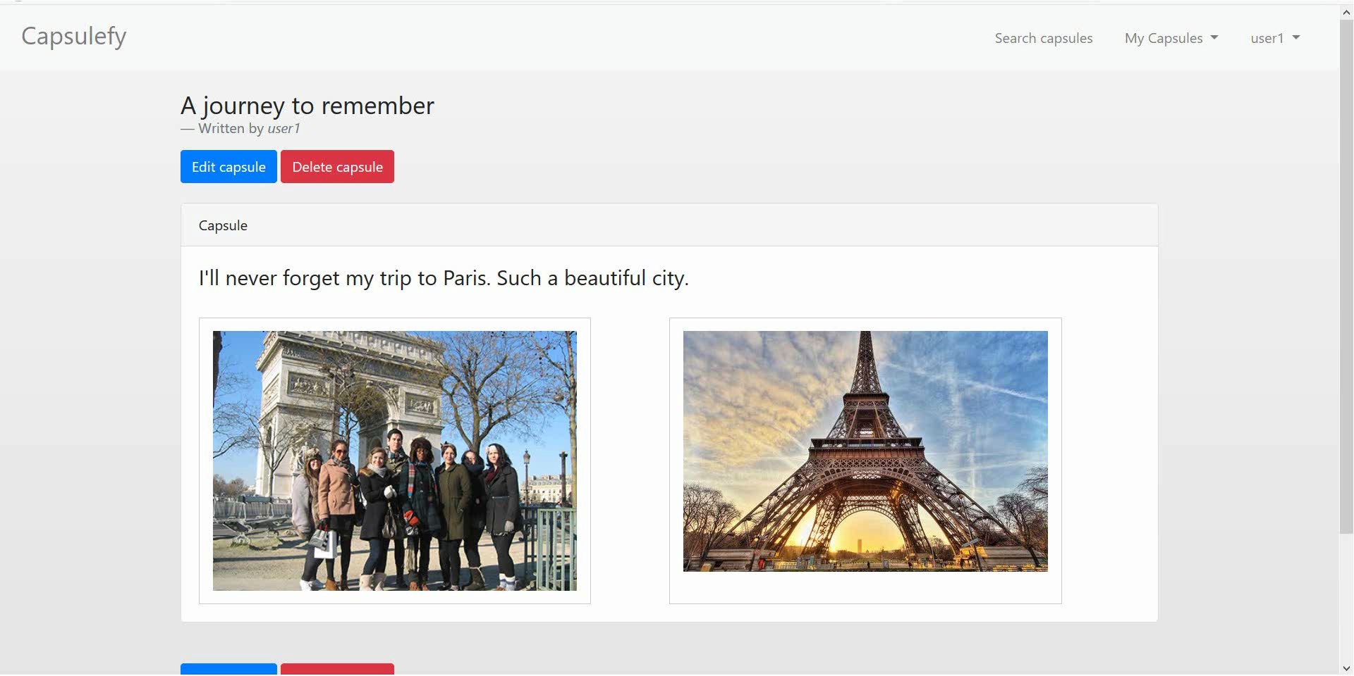
Logged-in user – Add and delete modules

Slide 53
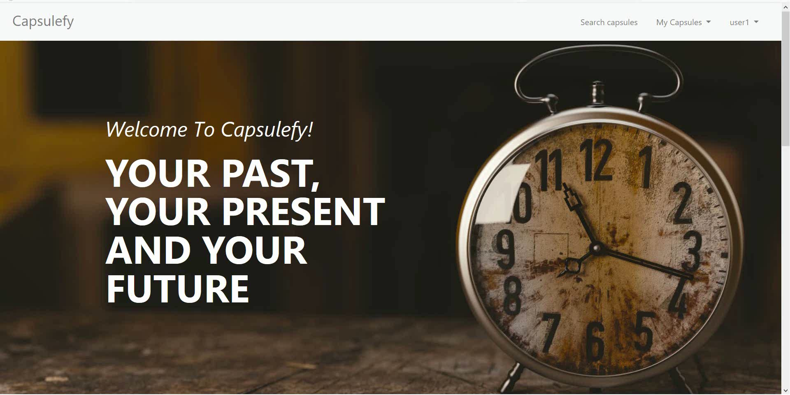
Logged-in user – Add and delete modules

Slide 54
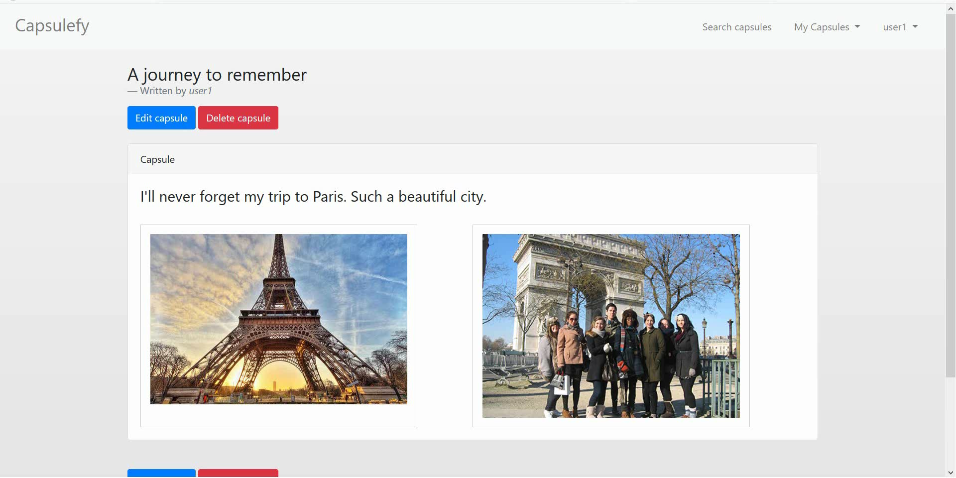
Logged-in user – Add and delete files

Slide 55
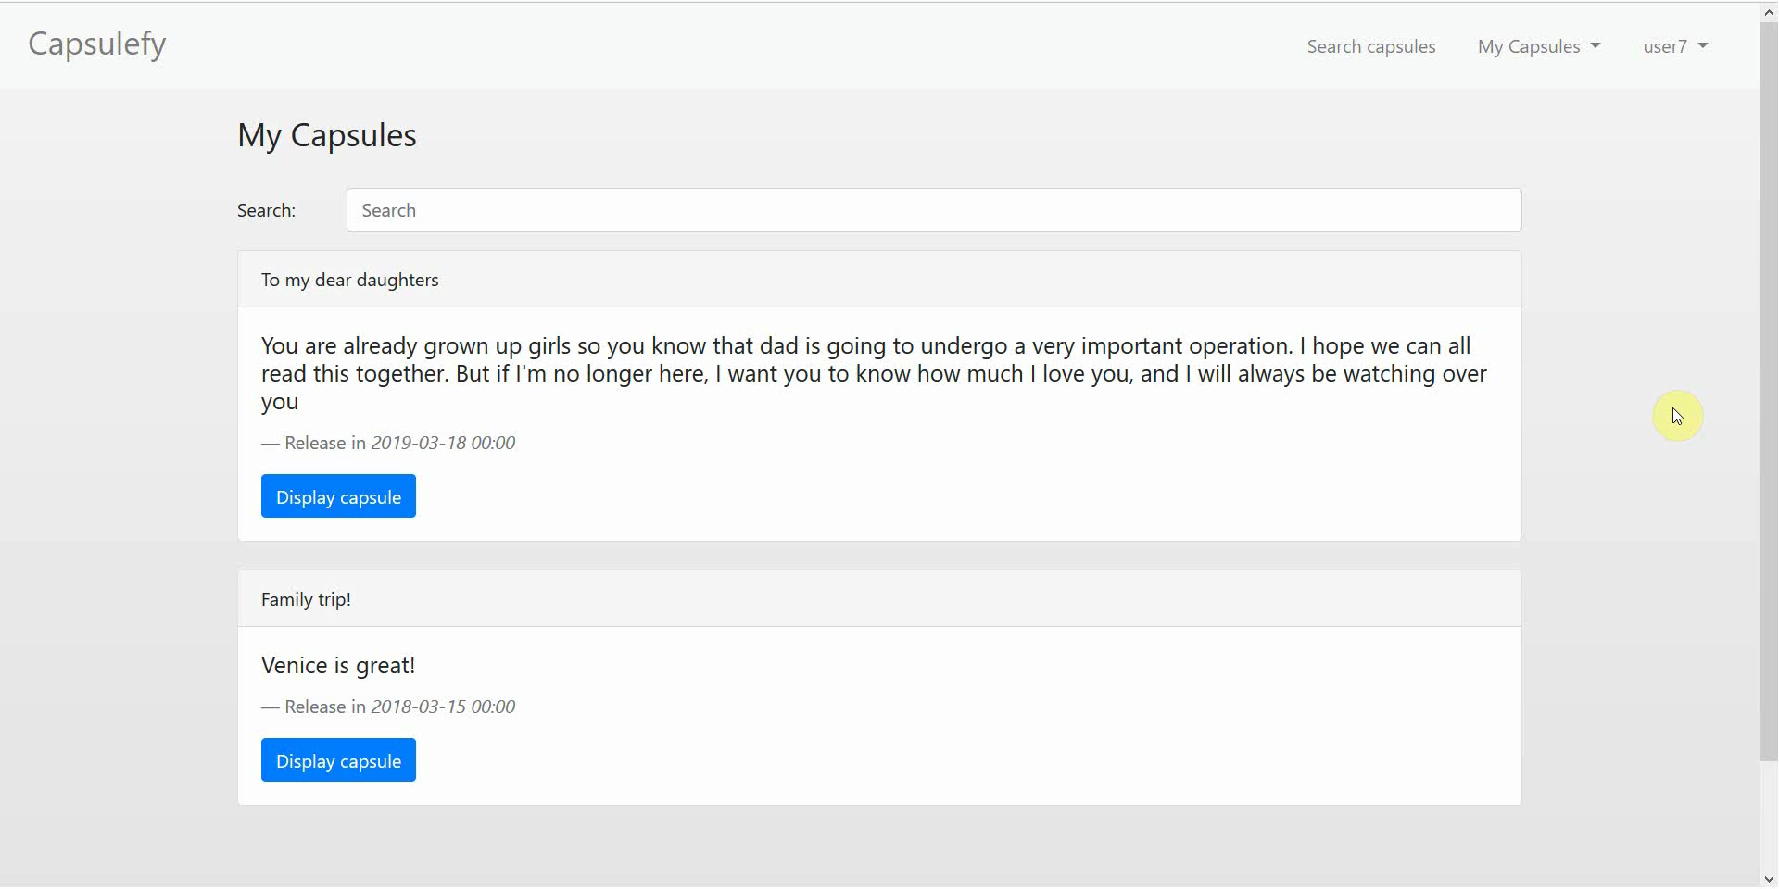
Logged-in user – Refresh capsules

Slide 56
SPRINT 2 WEEK 1
April 1st – April 7hth

Slide 57
Task | Assignees | Start | End | Est. (h)
Initial meeting | All | Apr 1 | Apr 1 | 1.5
Local settings | Daniel | Apr 2 | Apr 2 | 1
User registration | Juan | Apr 2 | Apr 2 | 2
Remove expired capsules | Pablo | Apr 2 | Apr 2 | 1.5
Twitter integration | Rafael | Apr 2 | Apr 4 | 4
Research payment options | Adrián | Apr 2 | Apr 4 | 2
Fix pagination issues | Daniel, Juan | Apr 3 | Apr 3 | 3
DM switch notifications | Pablo | Apr 3 | Apr 4 | 1.5
TIME

Slide 58
Task | Assignees | Start | End | Est. (h)
User interface | Daniel | Apr 4 | Apr 7 | 5
Ban users | Juan | Apr 4 | Apr 6 | 2
Automation improvements | Pablo | Apr 4 | Apr 7 | 4
Basic payment | Adrián | Apr 5 | Apr 7 | 4
Presentation | Rafael | Apr 5 | Apr 6 | 3
Pilot users feedback | Adrián | Apr 6 | Apr 6 | 1
Rehearsal | Pablo | Apr 7 | Apr 7 | 1.5
TIME

Slide 59
SPRINT 2 WEEK 2
April 8th – April 12th

Slide 60
Task | Assignees | Start | End | Est. (h)
Feedback meeting | All | Apr 8 | Apr 8 | 1.5
User interface | Daniel | Apr 9 | Apr 11 | 7
Facebook integration | Rafael | Apr 9 | Apr 11 | 4
Premium payments | Adrián | Apr 9 | Apr 10 | 4
Admin dashboard | Juan | Apr 9 | Apr 10 | 3
Jmeter performance tests | Pablo | Apr 9 | Apr 11 | 4
SonarCloud set up | Adrián | Apr 11 | Apr 12 | 3
Edit notification email | Juan | Apr 11 | Apr 11 | 2
TIME

Slide 61
Task | Assignees | Start | End | Est. (h)
Sprint review Sprint 3 planification | All | Apr 11 | Apr 11 | 1.5
Presentation | Rafael | Apr 11 | Apr 12 | 3
Deliverable | Pablo | Apr 11 | Apr 12 | 4
TIME

Slide 62
PILOTING PLAN
How will users test Capsulefy?

Slide 63


Create manual
Create test suite
Test the system
Gather feedback
Fill form

Slide 64
Committed users
Name | Age
Francisco R. | 55
Javier A. | 19
Valentin A. | 19
Antonio G. | 26
Name | Age
José Manuel J. | 21
Sandra C. | 28
José Manuel C. | 21

Slide 65
Sprint 2
Users receive and fill form
March 30 – April 6
Development
April 8 – April 12
Receive users feedback
April 6
Planification
April 8

Slide 66
Sprint 3
Easter Week
Users receive and fill form
April 12 – April 22
Development
April 22 – May 3
Receive users feedback
April 22
Planification
April 22

Slide 67
After development
Users receive and fill form
May 4 – May 12
Receive users feedback
May 12
Planification
May 13

Slide 68
Documentation
Manual (PDF)
Test suite
Form
https://forms.gle/DWs2JPuyyd8hnbjg6

Slide 69
Thanks!
Upstream: https://capsulefy.herokuapp.com
Sprint 1: https://capsulefy02.herokuapp.com
capsulefy.communications@gmail.com
Pilot users form: https://forms.gle/DWs2JPuyyd8hnbjg6
Original mockups: https://marvelapp.com/4395g15/screen/53795517

Slide 70




Teamwork
Skills
Profitable work
Positive feedback

Slide 71



Risk | Mitigation
Broken computer | Risk prevention funds
Changing terms of use | Monitor
Servers down | Monitor
Incompatible timetables | Reschedule

